Slide 1



OSS NuGet Package Explorer: From WPF to WinUI and running in Browser
Jerome Laban| CTO, Uno Platform
@jlaban | @UnoPlatform

Slide 2
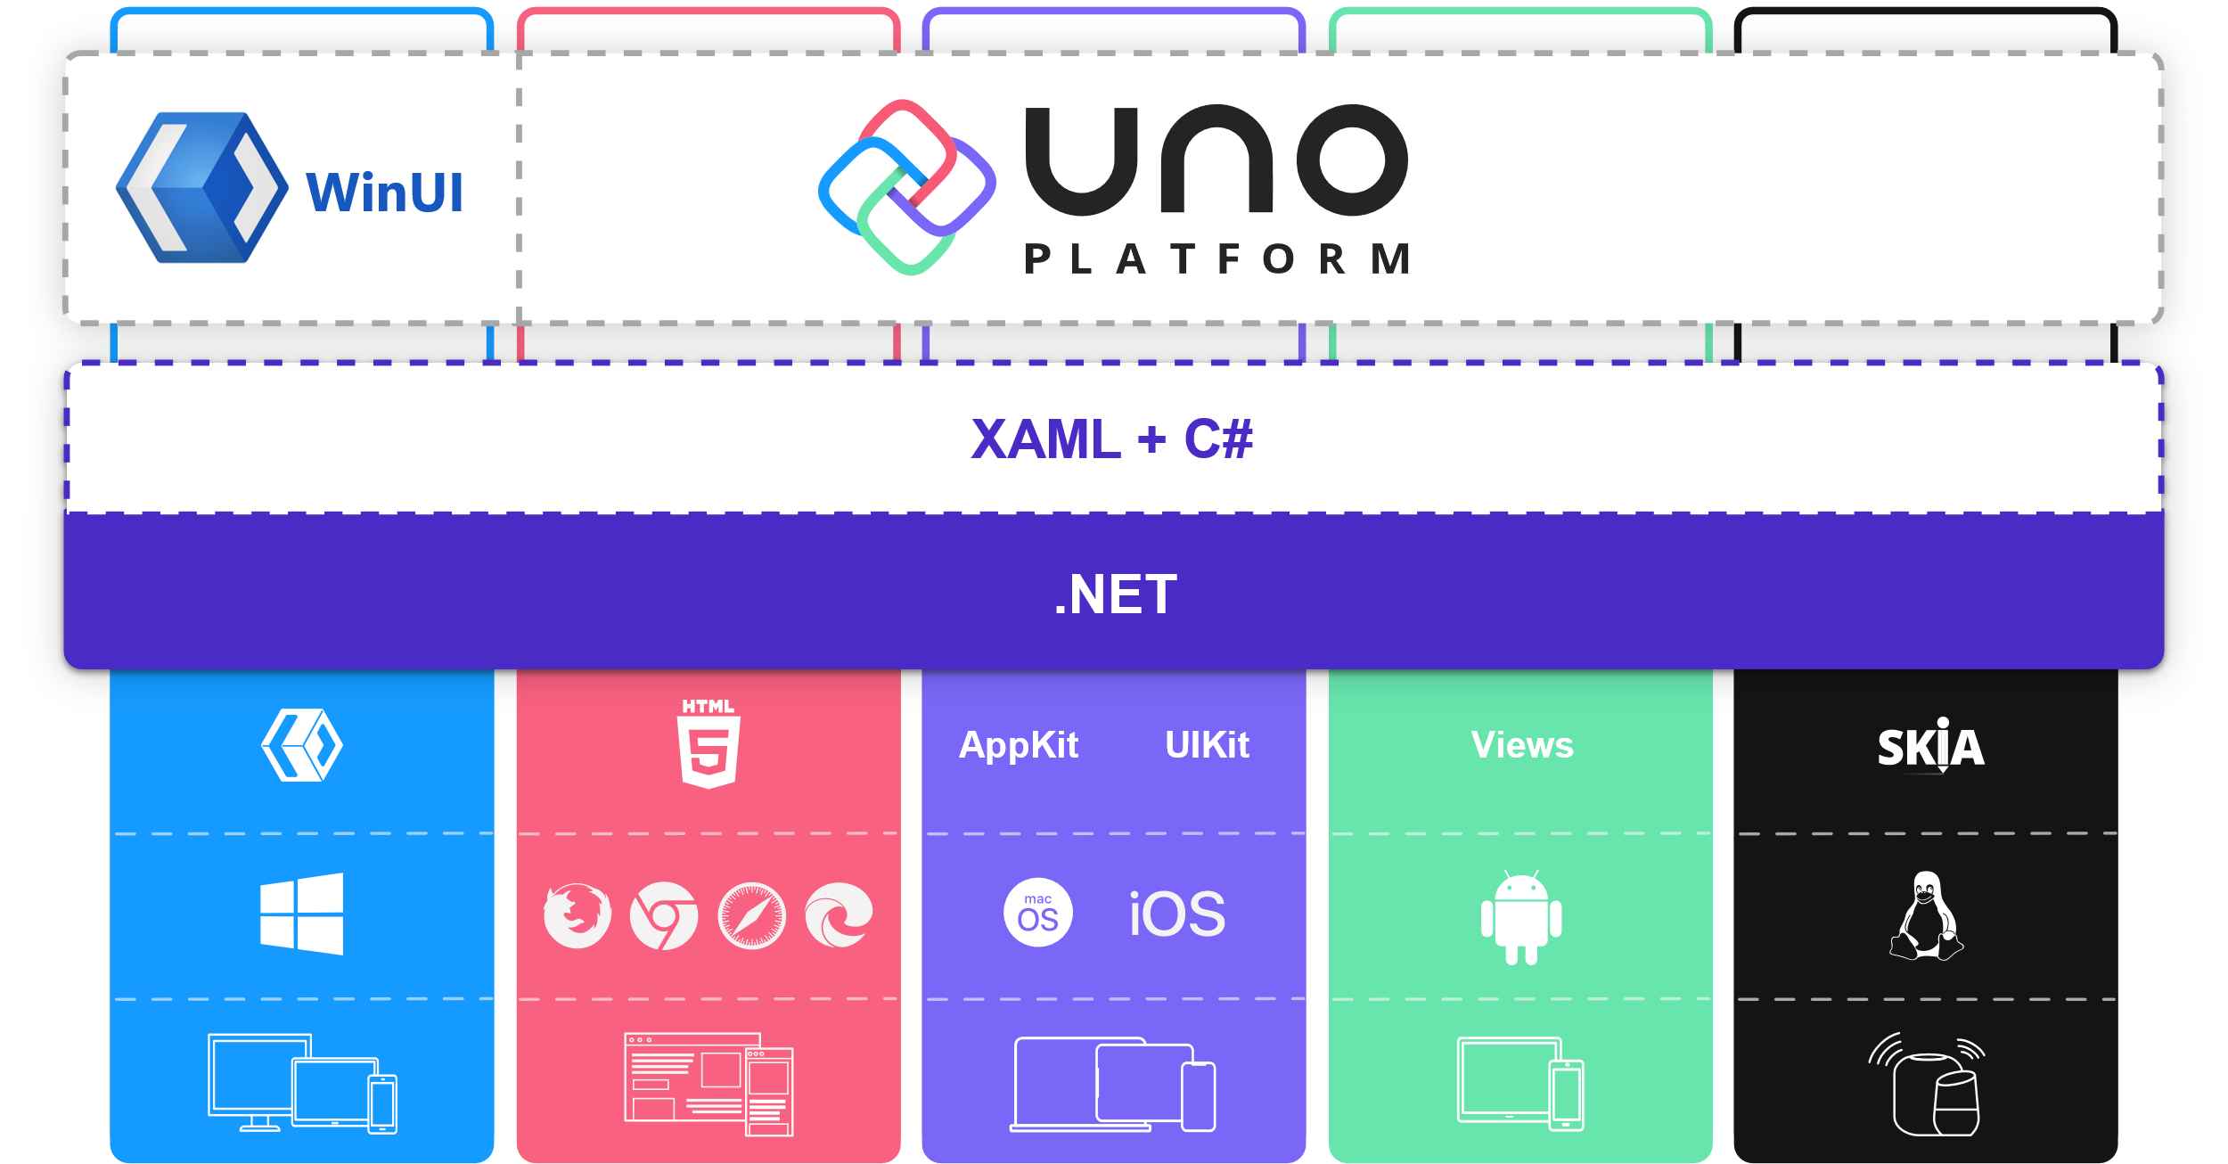
Uno Platform
Bringing XAML enterprise apps to the Web and beyond
WinUI XAML + C#
Pixel-Perfect
Single Codebase
Everywhere .NET runs
3rd party Ecosystem
Free and Open-Source
GitHub/UnoPlatform

Slide 3

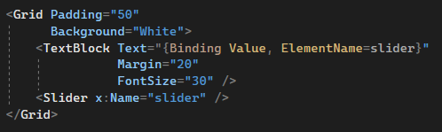
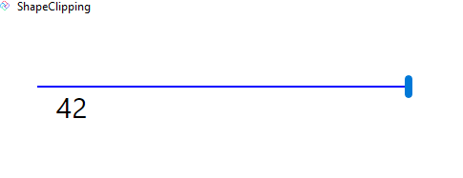
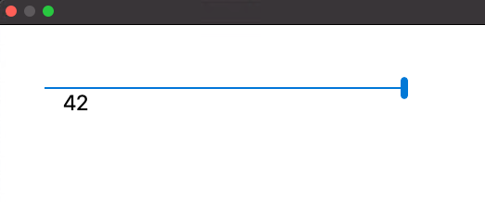
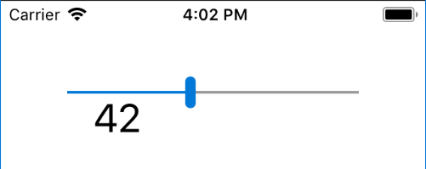
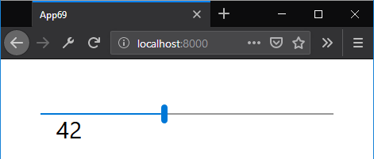
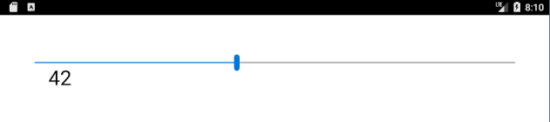
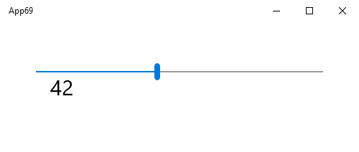
XAML
Linux
macOS
iOS
WebAssembly
Windows
Android

Slide 4

WebAssembly
Inception
Lottie
Hot Reload
1.0
2.0
SkiaSharp
WebAssembly
Syncfusion Preview
Entity
Framework
2013
2018
2019
2020
Windows
Community
Toolkit
ReactiveUI
UI Testing
Full AOT
Windows 7
WebAssembly Migration
Mixed Mode AOT
Open Source

Slide 5
WinUI & Perf
3.8
2.4
3.6
3.1
3.0 Preview
macOS
WinUI RTM
Linux
WinUI 3.0
3.3
3.6
2.0
3.0
.NET 6
RC1
Prism
Android X
WinUI Pre 4
Material & Fluent UI
Android 11
WinUI Preview 3
3.10
Gitpod
x:Bind
3.5
2020
2021
MSAL.NET
SQLite
VS Code
3.4
Hot Restart
Surface Duo
Infragistics
3.7
Profile-Guided
AOT
WinAppSDK
Android 10
.NET 5
3.2
3.9
.NET 6
Mobile

Slide 6

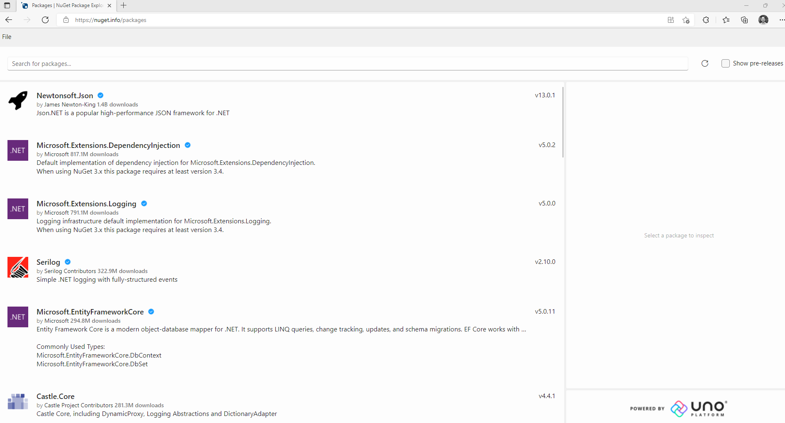
NuGet Package Explorer on the Web!
https://NuGet.info

Slide 7
Demo
Jerome Laban

Slide 8
Summary & Lessons Learned (1/2)
NPE for Windows / MVVM WPF Application / Structure
UI Layer recreation and reuse for Uno Platform
UI services (e.g. popups, File Open), Converters
Adjustments for platform specific APIs
Crypto, PDB reading
.NET 6, WinUI, Windows Community Toolkit powered
TabView, Expander, TreeView, DataGrid

Slide 9
Summary & Lessons Learned (2/2)
Text formatting via Monaco Editor
PWA out of the box
Azure Static WebApp deployment
CDN challenges with immutable caching

Slide 10

Next steps in NPE evolution. Join in!
Desktop and Web versions continue to co-exist
Further improvements in UI/UX
Creation and edition of packages
Using alternate feeds
Signing packages
More PWA Integrations (e.g. file association)
github.com/NuGetPackageExplorer/

Slide 11


Thanks for joining!
For more, come to www.UnoConf.com (Nov 30th)

